Slide 1
backpropagation
David Kauchak
CS158 – Fall 2023

Slide 2
Admin
Assignment 7
Assignment 8 released on Monday. Start ASAP!

Slide 3
Neural network
inputs
Individual perceptrons/neurons
Notes:
- often we view a slice of them

Slide 4
Neural network
some inputs are provided/entered
inputs
Notes:
- often we view a slice of them

Slide 5
Neural network
inputs
each perceptron computes and calculates an answer
Notes:
- often we view a slice of them

Slide 6
Neural network
inputs
those answers become inputs for the next level
Notes:
- often we view a slice of them

Slide 7
Neural network
inputs
finally get the answer after all levels compute
Notes:
- often we view a slice of them

Slide 8
A neuron/perceptron
Input x₁
Weight w₁
Weight w₂
Input x₂
Output y
activation function
Input x₃
Weight w₃
Weight w₄
Input x₄

Slide 9
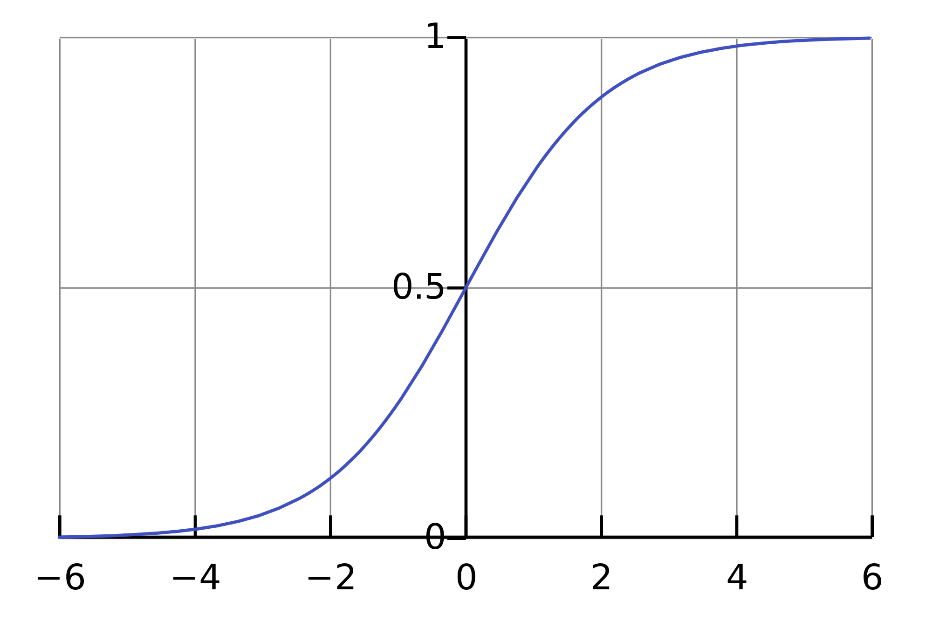
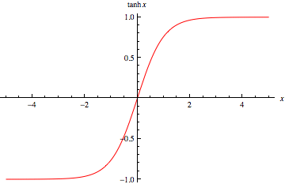
Activation functions
hard threshold:
sigmoid
tanh x

Slide 10
Training
?
Input x₁
?
?
Output = x₁ xor x₂
b=?
?
?
?
b=?
Input x₂
x₁ | x₂ | x₁ xor x₂
0 | 0 | 0
0 | 1 | 1
1 | 0 | 1
1 | 1 | 0
b=?
How do we learn the weights?

Slide 11
Learning in multilayer networks
Challenge: for multilayer networks, we don’t know what the expected output/error is for the internal nodes!
how do we learn these weights?
w
w
w
w
w
w
w
w
w
expected output?
w
w
w
perceptron/ linear model
neural network

Slide 12
Backpropagation: intuition
Gradient descent method for learning weights by optimizing a loss function
calculate output of all nodes
calculate the weights for the output layer based on the error
“backpropagate” errors through hidden layers

Slide 13
Backpropagation: intuition
We can calculate the actual error here

Slide 14
Backpropagation: intuition
Key idea: propagate the error back to this layer

Slide 15
Backpropagation: intuition
w₂
w₁
w₃
error
error for node is ~ w_{i} * error

Slide 16
Backpropagation: intuition
w₅
w₄
w₆
~w₃ * error
Calculate as normal, but weight the error

Slide 17
Backpropagation: the details
Gradient descent method for learning weights by optimizing a loss function
calculate output of all nodes
calculate the updates directly for the output layer
“backpropagate” errors through hidden layers
squared error

Slide 18
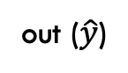
Backpropagation: the details
Notation:
m: features/inputs
d: hidden nodes
h_{k}: output from hidden node k
x₁
h₁
out ($\hat{y}$)
…
…
x_{m}
h_{d}
How many weights (ignore bias for now)?

Slide 19
Backpropagation: the details
Notation:
m: features/inputs
d: hidden nodes
h_{k}: output from hidden nodes
x₁
h₁
v₁
out ($\hat{y}$)
…
…
v_{d}
x_{m}
h_{d}
d weights: denote v_{k}

Slide 20
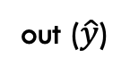
Backpropagation: the details
Notation:
m: features/inputs
d: hidden nodes
h_{k}: output from hidden nodes
x₁
h₁
v₁
out ($\hat{y}$)
…
…
v_{d}
x_{m}
h_{d}
How many weights?

Slide 21
Backpropagation: the details
Notation:
m: features/inputs
d: hidden nodes
h_{k}: output from hidden nodes
w₁₁
x₁
w₂₁
h₁
w₃₁
v₁
out ($\hat{y}$)
…
…
v_{d}
x_{m}
w_{dm}
h_{d}
d * m: denote w_{kj}
first index = hidden node
second index = feature
w₂₃: weight from input 3 to hidden node 2
w₄: all the m weights associated with hidden node 4

Slide 22
Backpropagation: the details
Gradient descent method for learning weights by optimizing a loss function
calculate output of all nodes
calculate the updates directly for the output layer
“backpropagate” errors through hidden layers

Slide 23
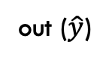
Backpropagation: the details
1. Calculate outputs of all nodes
w₁₁
x₁
w₂₁
h₁
w₃₁
v₁
out ($\hat{y}$)
…
…
v_{d}
x_{m}
w_{dm}
h_{d}
What are h_{k} in terms of x and w?

Slide 24
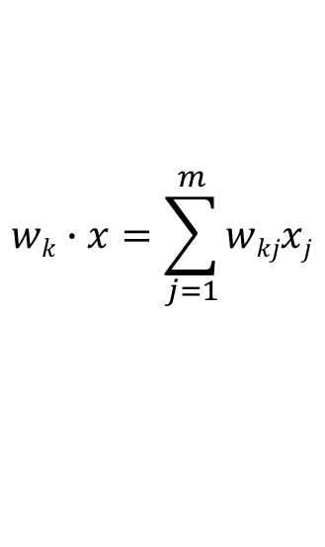
Backpropagation: the details
1. Calculate outputs of all nodes
w₁₁
x₁
w₂₁
h₁
w₃₁
v₁
out ($\hat{y}$)
…
…
v_{d}
x_{m}
w_{dm}
$$wk∙x=\sum_{j=1}^{m}{wkjxj}$$
h_{d}
f is the activation function

Slide 25
Backpropagation: the details
1. Calculate outputs of all nodes
w₁₁
x₁
w₂₁
h₁
w₃₁
v₁
out ($\hat{y}$)
…
…
v_{d}
x_{m}
w_{dm}
h_{d}
f is the activation function

Slide 26

Backpropagation: the details
1. Calculate outputs of all nodes
w₁₁
x₁
w₂₁
h₁
w₃₁
v₁
out ($\hat{y}$)
…
…
v_{d}
x_{m}
w_{dm}
h_{d}
What is out in terms of h and v?

Slide 27
Backpropagation: the details
1. Calculate outputs of all nodes
w₁₁
x₁
w₂₁
h₁
w₃₁
v₁
out ($\hat{y}$)
…
…
v_{d}
x_{m}
w_{dm}
h_{d}

Slide 28
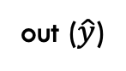
Backpropagation: the details
2. Calculate new weights for output layer
h₁
v₁
out ($\hat{y}$)
…
v_{d}
h_{d}
Want to take a small step towards decreasing loss. How?

Slide 29
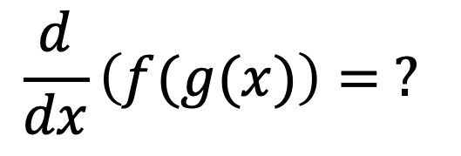
Recall: derivative chain rule
$$\frac{d}{dx}\left(f(g(x)\right)= ?$$

Slide 30
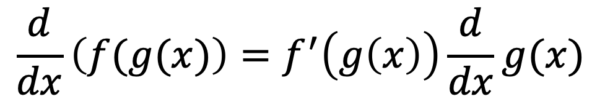
Recall: derivative chain rule
$$\frac{d}{dx}\left(f(g(x)\right)=f^{′}\left(g\left(x\right)\right)\frac{d}{dx}g(x)$$

Slide 31
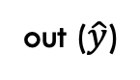
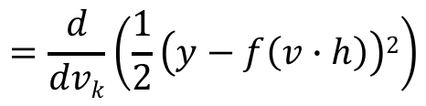
Output layer weights
h₁
v₁
out ($\hat{y}$)
…
v_{d}
h_{d}
$$=\frac{d}{dvk}\left(\frac{1}{2}\left(y−f\left(v∙h\right)\right)2\right)$$

Slide 32
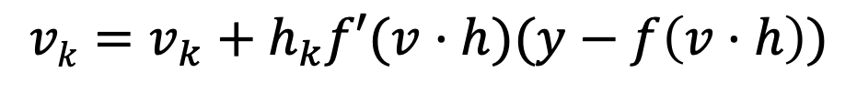
Output layer weights
h₁
v₁
out ($\hat{y}$)
…
v_{d}
h_{d}
The actual update is a step towards decreasing loss:
$$vk=v_{k}+h_{k}f′(v·h)(y−f\left(v·h\right))$$

Slide 33
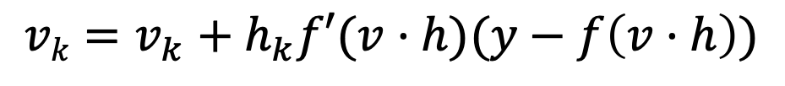
Output layer weights
$$vk=v_{k}+h_{k}f′(v·h)(y−f\left(v·h\right))$$
h₁
v₁
out ($\hat{y}$)
…
v_{d}
h_{d}
What are each of these?
Do they make sense individually?

Slide 34
Output layer weights
$$vk=v_{k}+h_{k}f′(v·h)(y−f\left(v·h\right))$$
h₁
v₁
out ($\hat{y}$)
…
v_{d}
h_{d}
size and direction of the feature associated with this weight
how far from correct and which direction
slope of the activation function where input is at

Slide 35
Output layer weights
$$vk=v_{k}+h_{k}f′(v·h)(y−f\left(v·h\right))$$
h₁
v₁
out ($\hat{y}$)
…
v_{d}
h_{d}
how far from correct and which direction
?

Slide 36
Output layer weights
$$vk=v_{k}+h_{k}f′(v·h)(y−f\left(v·h\right))$$
h₁
v₁
out ($\hat{y}$)
…
v_{d}
h_{d}
how far from correct and which direction
prediction < label:
increase the weight
prediction > label:
decrease the weight
bigger difference = bigger change

Slide 37
Output layer weights
$$vk=v_{k}+h_{k}f′(v·h)(y−f\left(v·h\right))$$
h₁
v₁
out ($\hat{y}$)
…
v_{d}
h_{d}
slope of the activation function where input is at
smaller step
bigger step
smaller step

Slide 38
Output layer weights
$$vk=v_{k}+h_{k}f′(v·h)(y−f\left(v·h\right))$$
h₁
v₁
out ($\hat{y}$)
…
v_{d}
h_{d}
size and direction of the feature associated with this weight
perceptron update:
gradient descent update:

Slide 39
Backpropagation: the details
Gradient descent method for learning weights by optimizing a loss function
calculate output of all nodes
calculate the updates directly for the output layer
“backpropagate” errors through hidden layers

Slide 40
Backpropagation
3. “backpropagate” errors through hidden layers
w₁₁
x₁
w₂₁
h₁
w₃₁
v₁
out
…
…
v_{d}
x_{m}
w_{dm}
h_{d}
Want to take a small step towards decreasing loss. How?

Slide 41
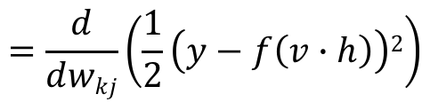
Hidden layer weights
w₁₁
x₁
h₁
w₁₂
v₁
w₁₃
out
…
…
$$=\frac{d}{dwkj}\left(\frac{1}{2}\left(y−f\left(v∙h\right)\right)2\right)$$
chain rule

Slide 42

Hidden layer weights
w₁₁
x₁
h₁
w₁₂
v₁
w₁₃
out
…
…
Remember: $wkj$ is the weight for hidden node $k$ from input $j$

Slide 43
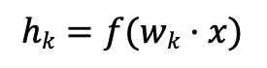
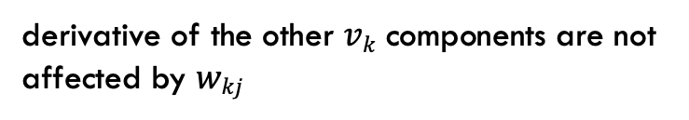
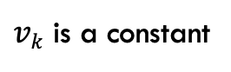
Hidden layer weights
w₁₁
x₁
h₁
w₁₂
v₁
w₁₃
out
…
…
derivative of the other $vk$ components are not affected by $wkj$
$vk$ is a constant
$$hk=f(wk·x)$$

Slide 44

Hidden layer weights
w₁₁
x₁
h₁
w₁₂
v₁
w₁₃
out
…
…
chain rule
$$=−x_{j}{f^{′}\left(wk·x\right)vk(f}^{′}\left(v·h\right)(y−f\left(v·h\right))$$

Slide 45
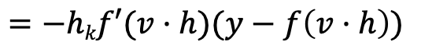

What happened here?
$$=−hkf′(v·h)(y−f\left(v·h\right))$$
$$=−xj{f^{′}\left(wk·x\right)vk(f}^{′}\left(v·h\right)(y−f\left(v·h\right))$$

Slide 46

w₁₁
x₁
h₁
w₁₂
v₁
w₁₃
out
…
…
What is the slope $vk$ with respect to $wkj$

Slide 47
What is the slope vh with respect to w_{kj}
w₁₁
x₁
h₁
w₁₂
v₁
w₁₃
out
…
…
input feature
weight from hidden layer to output layer
slope of wx

Slide 48

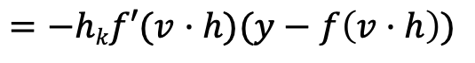
Backpropagation
output layer
hidden layer
$$=−hkf′(v·h)(y−f\left(v·h\right))$$
$$=−xj{f^{′}\left(wk·x\right)vkf}^{′}\left(v·h\right)(y−f\left(v·h\right))$$
What’s different?
w₁₁
x₁
w₂₁
h₁
w₃₁
v₁
out
…
…
v_{d}
x_{m}
w_{dm}
h_{d}

Slide 49
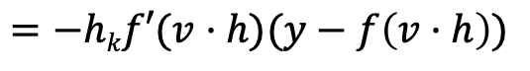


Backpropagation
output layer
hidden layer
$$=−hkf′(v·h)(y−f\left(v·h\right))$$
$$=−xj{f^{′}\left(wk·x\right)vkf}^{′}\left(v·h\right)(y−f\left(v·h\right))$$
output activation slope
error
input
output activation slope
error
input
w₁₁
x₁
w₂₁
h₁
w₃₁
v₁
out
…
…
v_{d}
x_{m}
w_{dm}
slope of $wx$
weight from hidden layer to output layer
h_{d}

Slide 50
Backpropagation
output layer
hidden layer
$$=−hkf′(v·h)(y−f\left(v·h\right))$$
$$=−xj{f^{′}\left(wk·x\right)vkf}^{′}\left(v·h\right)(y−f\left(v·h\right))$$
output activation slope
error
input
output activation slope
error
input
w₁₁
x₁
w₂₁
h₁
w₃₁
v₁
out
…
…
v_{d}
x_{m}
w_{dm}
how much of the error came from this hidden node
how much do we need to change
h_{d}

Slide 51
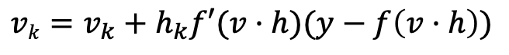
Backpropagation generalization
output layer
$$vk=v_{k}+h_{k}f′(v·h)(y−f\left(v·h\right))$$
modified error
derivative of input at node
error

Slide 52

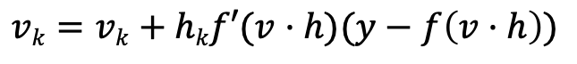
Backpropagation generalization
output layer
hidden layer
$$vk=vk+hkf′(v·h)(y−f\left(v·h\right))$$
$$wkj=w_{kj}+x_{j}{f′(wk·x) v_{k}^{}f}^{′}\left(v·h\right) (y−f\left(v·h\right))$$
Can we write this more succinctly?

Slide 53
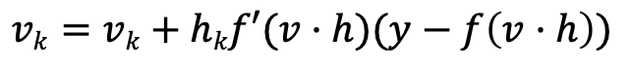

Backpropagation generalization
output layer
hidden layer
$$vk=vk+hkf′(v·h)(y−f\left(v·h\right))$$
$$wkj=wkj+xj{f′(wk·x)vkf}^{′}\left(v·h\right) (y−f\left(v·h\right))$$

Slide 54
Backpropagation generalization
output layer
hidden layer
weight to output layer
modified error of output layer

Slide 55
Backprop on multilayer networks
Anything different at this layer?

Slide 56
Backprop on multilayer networks
What “errors” at the next layer does the highlighted edge affect?

Slide 57
Backprop on multilayer networks

Slide 58
Backprop on multilayer networks
What “errors” at the next layer does the highlighted edge affect?

Slide 59
Backprop on multilayer networks

Slide 60
Backprop on multilayer networks

Slide 61
Backprop on multilayer networks
…
…
Backpropagation:
Calculate new weights and modified errors at output layer
Recursively calculate new weights and modified errors on hidden layers based on recursive relationship
Update model with new weights

Slide 62
Multiple output nodes
How does multiple outputs change things?

Slide 63
Multiple output nodes
How does multiple outputs change things?

Slide 64
Backpropagation implementation
Output layer update:
Hidden layer update:
Any missing information for implementation?

Slide 65
Backpropagation implementation
Output layer update:
Hidden layer update:
What activation function are we using
What is the derivative of that activation function

Slide 66
Activation function derivatives
sigmoid
tanh

Slide 67
Learning rate
Output layer update:
Hidden layer update:
Like gradient descent for linear classifiers, use a learning rate
Often will start larger and then get smaller

Slide 68
Backpropagation implementation
Just like gradient descent!
for some number of iterations:
randomly shuffle training data
for each example:
Compute all outputs going forward
Calculate new weights and modified errors at output layer
Recursively calculate new weights and modified errors on hidden layers based on recursive relationship
Update model with new weights
Notes:
- Make sure to calculate all of the outputs and modified errors *before* updating any of the model weights

Slide 69
Handling bias
w₁₁
x₁
w₂₁
h₁
w₃₁
v₁
out
…
…
v_{d}
x_{m}
w_{dm}
h_{d}
How should we learn the bias?

Slide 70
Handling bias
w₁₁
x₁
w₂₁
h₁
w₃₁
v₁
out
…
…
v_{d}
x_{m}
w_{dm}
…
v_{d+1}
h_{d}
1
1
w_{d(m+1)}
Add an extra feature hard-wired to 1 to all the examples
For other layers, add an extra parameter whose input is always 1

Slide 71
Online vs. batch learning
for some number of iterations:
randomly shuffle training data
for each example:
Compute all outputs going forward
Calculate new weights and modified errors at output layer
Recursively calculate new weights and modified errors on hidden layers based on recursive relationship
Update model with new weights
Online learning: update weights after each example
Batch learning?
Notes:
- Make sure to calculate all of the outputs and modified errors *before* updating any of the model weights

Slide 72
Batch learning
for some number of iterations:
randomly shuffle training data
initialize weight accumulators to 0 (one for each weight)
for each example:
Compute all outputs going forward
Calculate new weights and modified errors at output layer
Recursively calculate new weights and modified errors on hidden layers based on recursive relationship
Add new weights to weight accumulators
Divide weight accumulators by number of examples
Update model weights by weight accumulators
Process all of the examples before updating the weights
Notes:
- Make sure to calculate all of the outputs and modified errors *before* updating any of the model weights

Slide 73
Many variations
Momentum: include a factor in the weight update to keep moving in the direction of the previous update
Mini-batch:
Compromise between online and batch
Avoids noisiness of updates from online while making more educated weight updates
Simulated annealing:
With some probability make a random weight update
Reduce this probability over time
…

Slide 74
Challenges of neural networks?
Picking network configuration
Can be slow to train for large networks and large amounts of data
Loss functions (including squared error) are generally not convex with respect to the parameter space

Slide 75
History of Neural Networks
McCulloch and Pitts (1943) – introduced model of artificial neurons and suggested they could learn
Hebb (1949) – Simple updating rule for learning
Rosenblatt (1962) - the perceptron model
Minsky and Papert (1969) – wrote Perceptrons
Bryson and Ho (1969, but largely ignored until 1980s--Rosenblatt) – invented backpropagation learning for multilayer networks

Slide 76
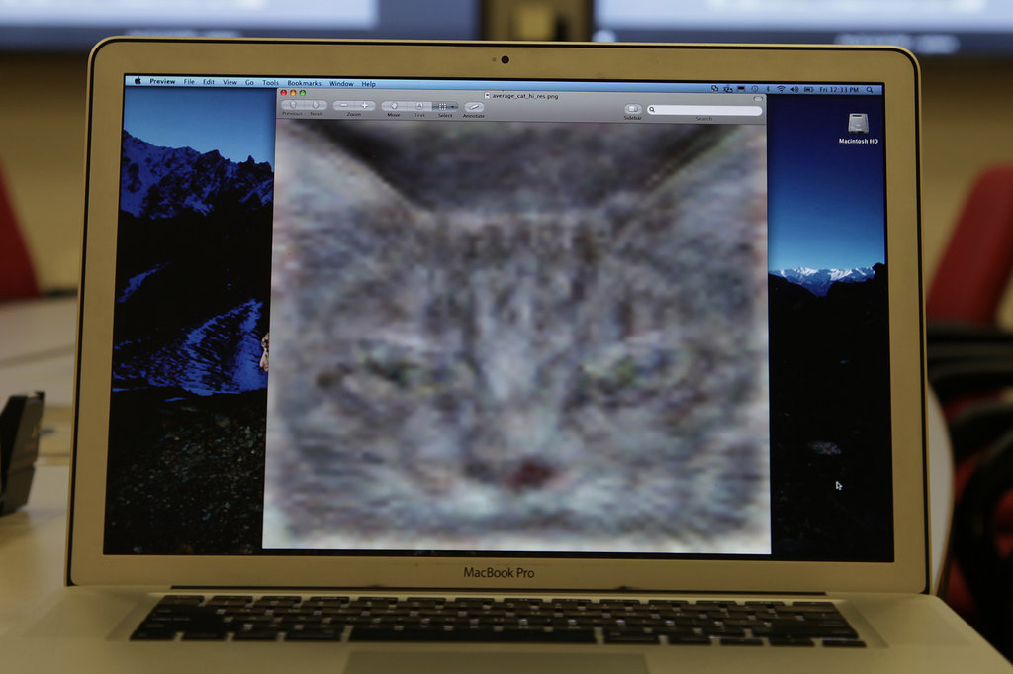

Slide 77
http://www.nytimes.com/2012/06/26/technology/in-a-big-network-of-computers-evidence-of-machine-learning.html?_r=0

